Slide 1



Workshop Day 1: software familiarization, forecast weather and oceanographic conditions, software feasibility.
Briefing
Chalmers University of Technology
April 5th, 2022

Slide 2
Briefing
State-of-the-art of the weather ship routing (WSR) systems
Inventory of grid & path-finding algorithms ➔ most suitable algorithm
Model implementation
Feasibility of the software

Slide 3
State-of-the-art of the weather ship routing (WSR)
Wide academic research on long distances → meteorological forecasts for oceans
Little study on short distances → dimensional resolution of weather scripts
Intention of EU to move freight from road to sea, in order to reduce external costs through the promotion of multimodal transport chains

Slide 4
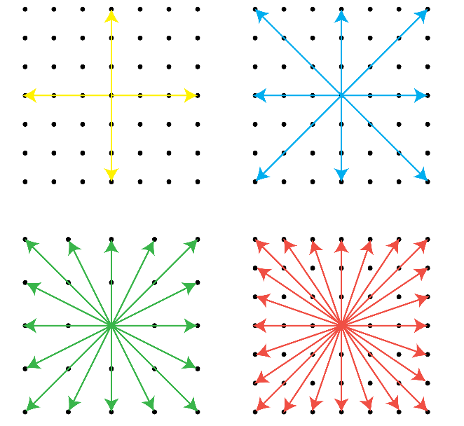
Inventory of grid
Nodal connection possibilities
Dijkstra & A* algorithms
Grid refinement
Notes:
These algorithms are applied at gridded scheme where each node is connected to a set of vicinity points.
The edges connecting nodes displayed by arrows for 4 different schemes: 4, 8, 16 and 24 edges. Each arrow represents potential ship courses or directions. Different grid resolution has been tested that a minimum 16 edges are required for the software.

Slide 5
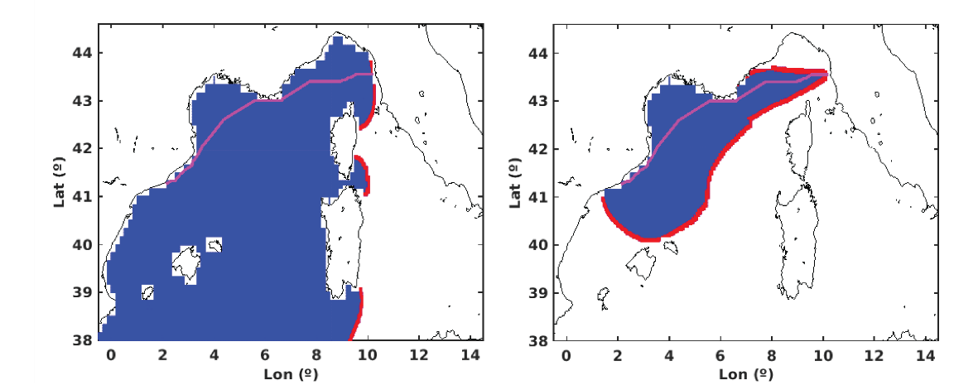
Inventory of different optimization path-finding algorithms → Dijkstra & A*
Same results have been obtained using both algorithms
Computational time reduction in a 60%

Slide 6
Model implementation
The wave predictions used are provided by the Copernicus website.
The optimum route suggests sailing northward than minimum distance route.
The travel time reduction 15% of the total time.

Slide 7
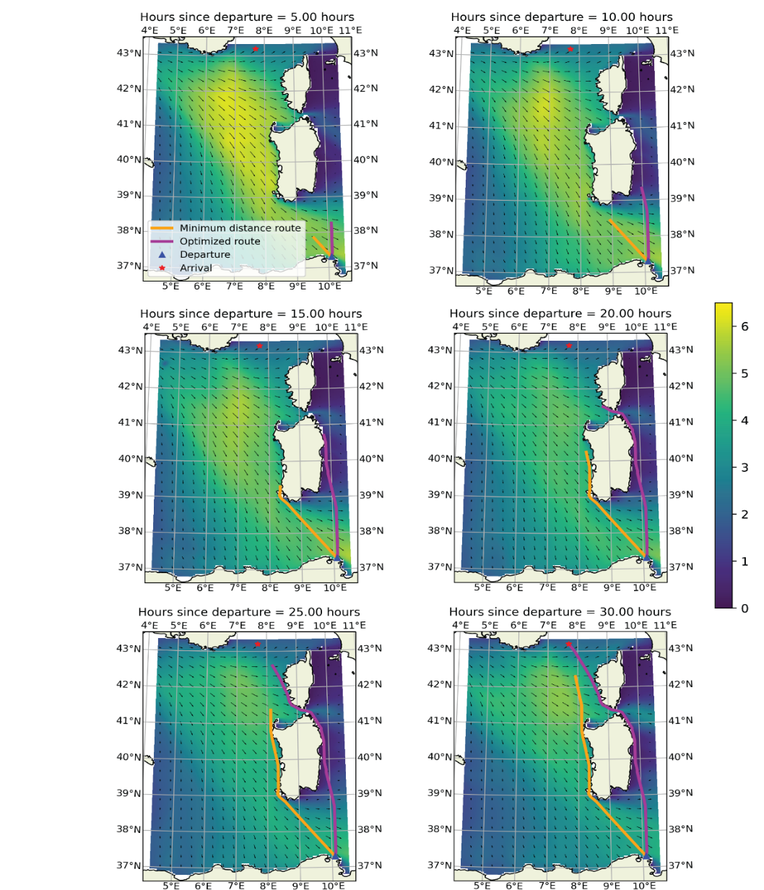
Temporal sequence of the snapshot of the Tunis – Nice route
Model implementation
Temporal sequence of the snapshot of the Tunis – Nice route (the optimal route magenta and the minimum distance route in yellow)

Slide 8

$$θ \text{is} \text{an} \text{angle} \text{off} \text{bow} \text{with} \text{respect} \text{to} \text{vessel}\text{’}\text{s} \text{heading} \text{direction} \text{measured}$$
c) Model implementation
Mannarini (inspired by Bowditch)
Aertssen
Khokhlov (suggested by Lubkovsky)

Slide 9

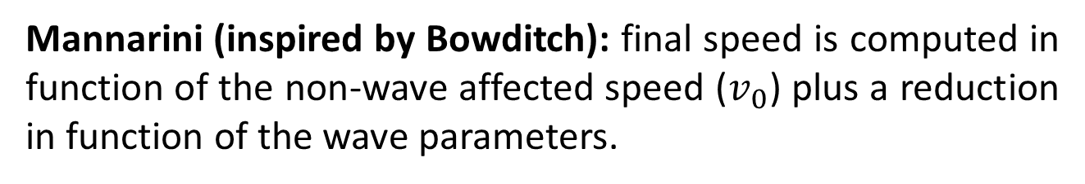
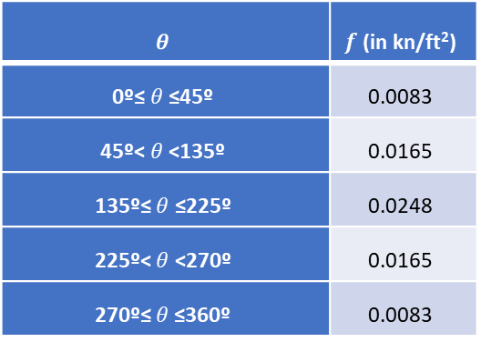
$$θ \text{is} \text{an} \text{angle} \text{off} \text{bow} \text{with} \text{respect} \text{to} \text{vessel}\text{’}\text{s} \text{heading} \text{direction} \text{measured}$$
Mannarini (inspired by Bowditch): final speed is computed in function of the non-wave affected speed ($v_{0}$) plus a reduction in function of the wave parameters.
$$v \left(Hs, θ\right)=v_{0}−f\left(θ\right)·{Hs}^{2}$$
$$θ$$ | $f$ (in kn/ft²)
0º≤ $θ$≤45º | 0.0083
45º< $θ$ <135º | 0.0165
135º≤ $θ$ ≤225º | 0.0248
225º< $θ$ <270º | 0.0165
270º≤ $θ$≤360º | 0.0083
$θ$is an angle off bow with respect to vessel’s heading direction measured

Slide 10
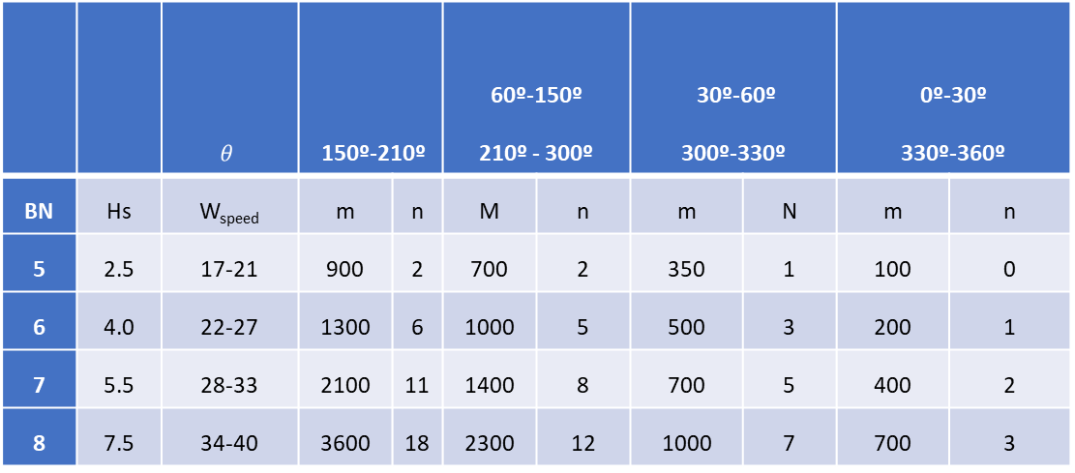
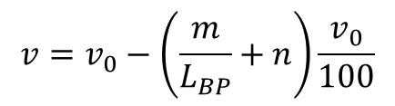
Aertssen: this formula includes ship dimensions (L_{BP}) in speed reduction in function of waves parameters.
$$v=v_{0}−\left(\frac{m}{L_{BP}}+n\right)\frac{v_{0}}{100}$$
 |  | $$θ$$ | 150º-210º |  | 60º-150º 210º - 300º |  | 30º-60º 300º-330º |  | 0º-30º 330º-360º
BN | Hs | W_{speed} | m | n | M | n | m | N | m | n
5 | 2.5 | 17-21 | 900 | 2 | 700 | 2 | 350 | 1 | 100 | 0
6 | 4.0 | 22-27 | 1300 | 6 | 1000 | 5 | 500 | 3 | 200 | 1
7 | 5.5 | 28-33 | 2100 | 11 | 1400 | 8 | 700 | 5 | 400 | 2
8 | 7.5 | 34-40 | 3600 | 18 | 2300 | 12 | 1000 | 7 | 700 | 3

Slide 11
Khokhlov (suggested by Lubkovsky): this formula takes into account vessels’ DWT and waves characteristics to calculate ship speed reduction.
Khokhlov method is applicable for:
Vessels from 4.000 to 20.000 DWT
Design speeds in between 9 and 20 knots.
$$v=v_{0}−\left(0.745·H_{s}−0.245·θ·H_{s}\right)·\left(1.0−1.35·{10}^{−6}·D·v_{0}\right)$$

Slide 12
Case study
BBF
3 routes, 5 ports
From calm waters to waves 8 meters high.
Bowditch, Aertssen and Khokhlov formulas

Slide 13
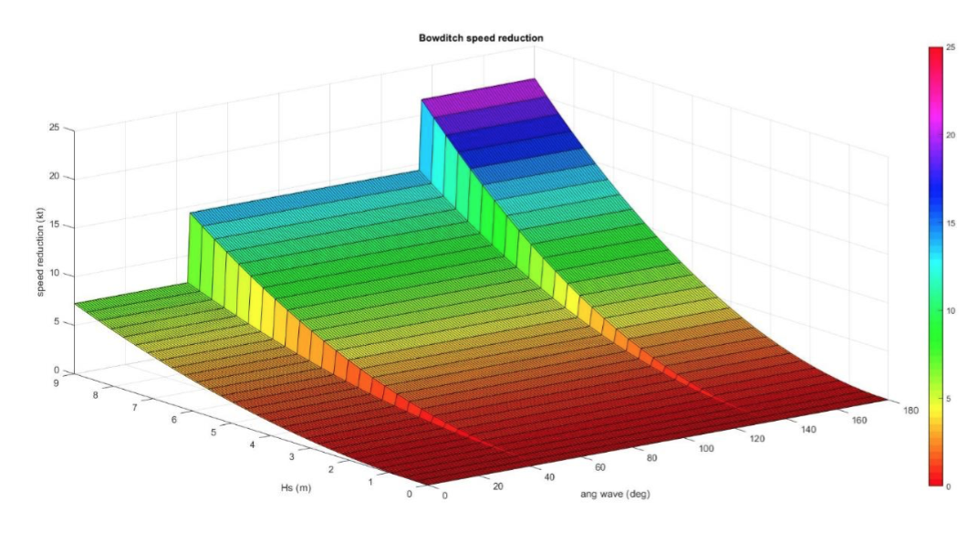
Case study
Speed reduction related to wave height and hitting angle variation based on Bowditch formulation

Slide 14
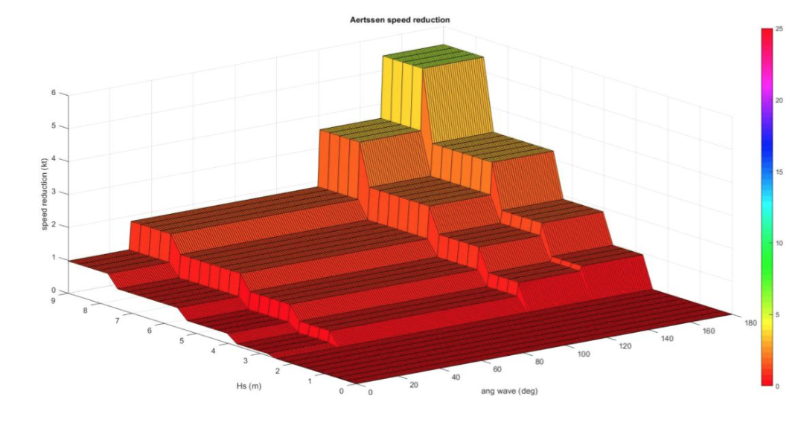
Case study
Speed reduction related to wave height and hitting angle variation based on Aertssen formulation

Slide 15
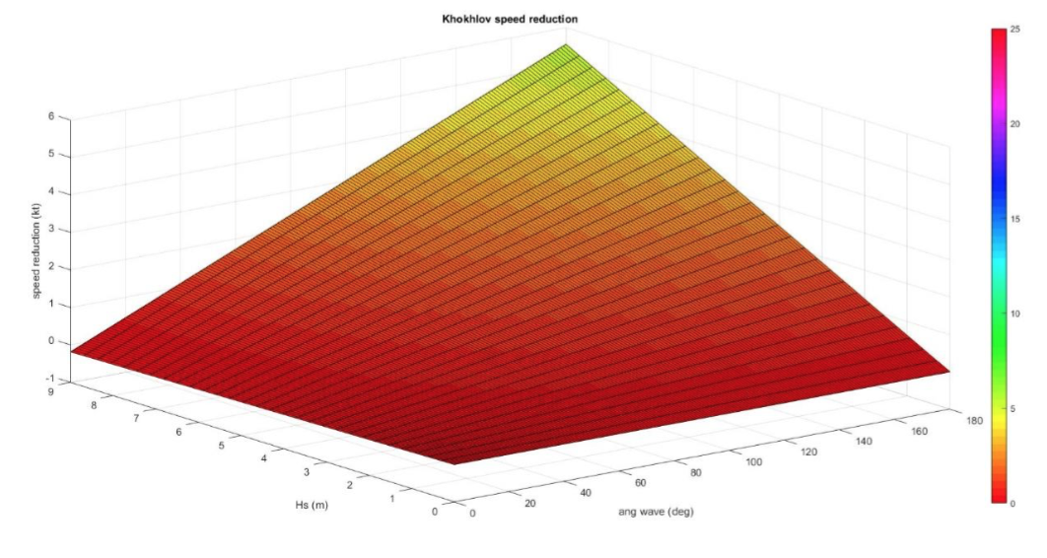
Case study
Speed reduction related to wave height and hitting angle variation based on Khokhlov formulation

Slide 16
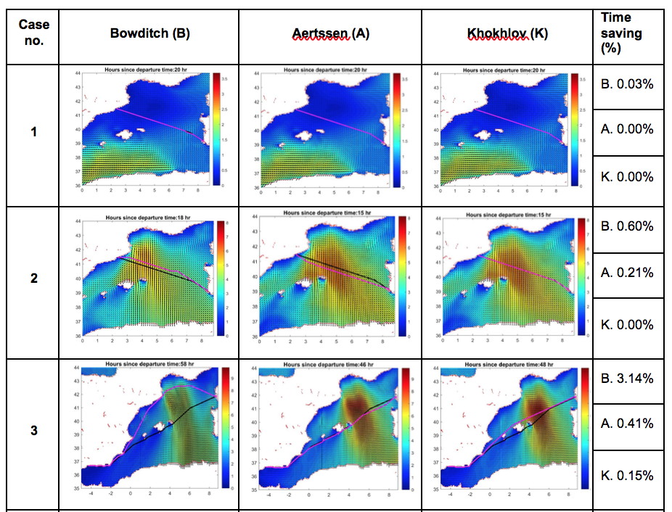
Case study

Slide 17
Feasibility of the software
4 routes have been analysed, related to 5 ports and leaving from Barcelona.
Different speeds and weather conditions were selected to check its feasibility previously in Balearic and Italy, routes.

Slide 18
Feasibility of the software
 | 10 knots | 16 knots | 22.6 knots | 30 knots
Calm-Smooth (0-0.5m) | No | No | No | No
Moderate-Rough (1.25 – 4m) - (FS) | No | No | No | No
Moderate-Rough (BS) | ½ | ½ | No | No
Moderate-Rough (HS) | ½ | ½ | No | No
Rough-High (FS) (4-9m) | Yes | Yes | ½ | ½
Rough-High (BS) | Yes | Yes | ½ | ½
Rough-High (HS) | Yes | Yes | Yes | Yes
FS (Following seas); BS (Beam seas); HS (Head seas). Yes (feasible); No (not feasible); ½ (not all the studied cases are feasible)

